Slide 1
Chapter 14
The Situation
Copyright ©2022 McGraw-Hill Education. All rights reserved. No reproduction or distribution without the prior written consent of McGraw-Hill Education.

Slide 2
Chapter Outline
Introduction
The task
The organization
The environment

Slide 3
The Situation
"When you’ve exhausted all possibilities, remember this: You haven’t!"
Robert H. Schuller, minister and author.

Slide 4
Introduction 1
Situational engineering: Leaders use their knowledge of how a situation affects leadership to proactively change the situation to improve the chances of success.
Situations often explain more about what is going on and what kinds of leadership behaviors will be best than any other single variable.
Appropriateness of a leader’s behavior in a group makes sense only in the situational context in which the behavior occurs.

Slide 5
Introduction 2
Situations, not someone’s traits or abilities, play the most important role in determining who emerges as a leader.
Historically, great leaders emerged during social upheavals, economic crises, or revolutions.
Researchers advocating the situational viewpoint believed that leaders were made, not born, and that prior leadership experience helped forge effective leaders.

Slide 6
Introduction 3
Role theory: Leaders’ behaviors depends on their perceptions of critical aspects of the situation.
Rules and regulations governing a job.
Role expectations of subordinates, peers, and superiors.
Nature of the task.
Feedback about subordinates’ performance.
Multiple-influence model: Distinguishes between microvariables, such as task characteristics, and macrovariables, such as the external environment, in the situation.
Macrovariables have a pervasive influence on the ways leaders act.
Main situational levels of abstraction: Task, organizational, and environmental.

Slide 7
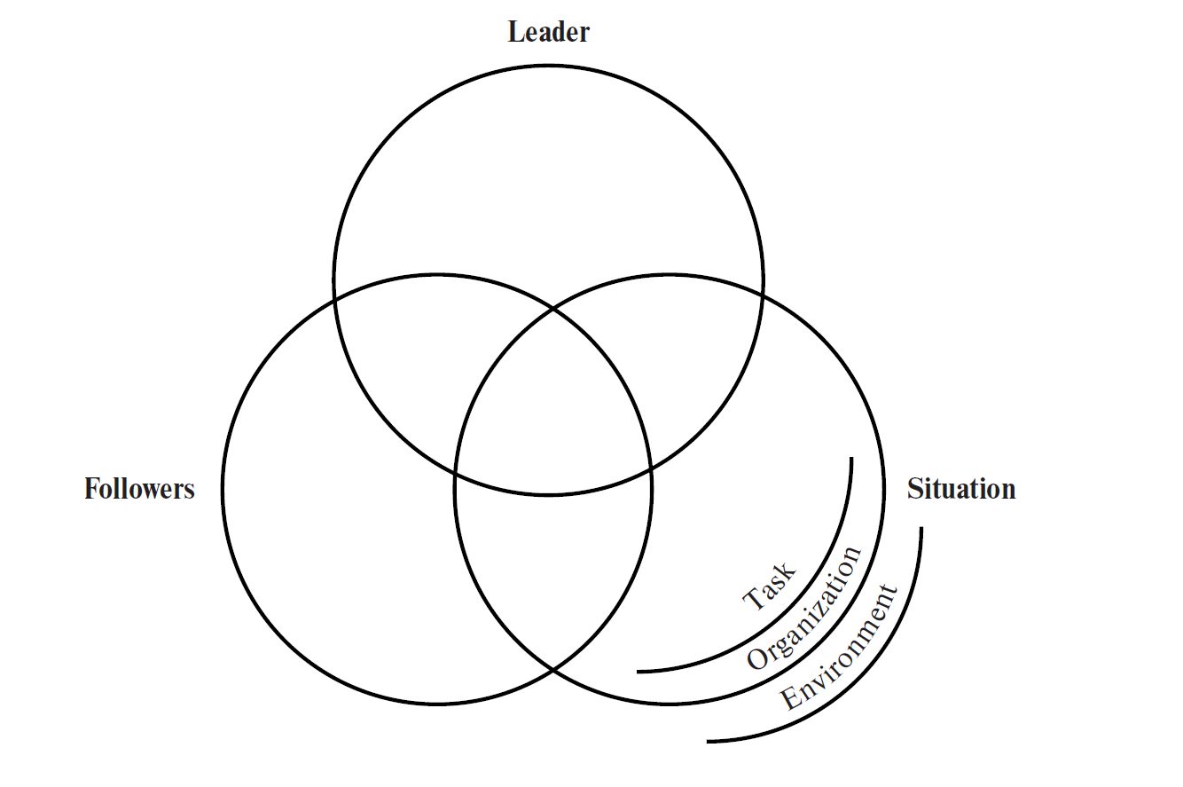
Figure 14.1: An Expanded Leader-Follower-Situation Model
Access the text alternative for slide images.

Slide 8
How Tasks Vary, and What That Means for
Leadership
Task autonomy: Degree to which a job provides an individual with some control over what he or she does and how he or she does it.
Task feedback: Degree to which a person accomplishing a task receives information about performance from performing the task itself.
Task structure: Degree to which a task is structured or unstructured.
Task interdependence: Degree to which tasks require coordination and synchronization for work groups or teams to accomplish desired goals.

Slide 9
Problems and Challenges
Technical problems: Challenges for which problem-solving resources already exist.
Resources have two aspects: Specialized methods and specialized expertise.
Can be solved without changing the nature of the social system in which they occur.
Adaptive problems: Cannot be solved using currently existing resources and ways of thinking.
Can be difficult reaching a common definition of what the problem really is.
Can be solved only by changing the system itself.
Require adaptive leadership for solutions.

Slide 10
From the Industrial Age to the Information Age 1
In the information age, many fundamental assumptions of the industrial age are be coming obsolete.
Kaplan and Norton have identified a new set of operating assumptions underlying the information age in terms of how companies operate.
    Cross functions: Organizations operates with integrated business processes that cut across traditional business functions.
    Links to customers and suppliers: Information technology enables organizations to integrate supply, production, and delivery processes and to realize improvements in cost, quality, and response time.
    Customer segmentation: Companies must learn to offer customized products and services to diverse customer segments.

Slide 11
From the Industrial Age to the Information Age 2
    Global scale: Companies today compete against the best companies throughout the entire world
    Innovation: As product life cycles continue to shrink, companies must be masters at anticipating customers’ future needs, innovating new products and services, and rapidly deploying new technologies into efficient delivery processes
    Knowledge workers: All employees must contribute value by what they know and by the information they can provide

Slide 12
The Formal Organization 1
Involves the disciplines of management, organizational behavior, and organizational theory.
Many aspects can have a profound impact on leadership.
Level of authority: Hierarchical level in an organization.
Organizational structure: The way an organization’s activities are coordinated and controlled.
    Represents another level of the situation in which leaders and followers must operate.

Slide 13
The Formal Organization 2
Organizational structures vary in complexity.
Horizontal complexity: Number of "boxes" at any particular organizational level in an organizational chart.
Vertical complexity: Number of hierarchical levels appearing on an organizational chart.
Spatial complexity: Describes the geographical dispersion of an organization’s members.
Organizations vary in their degree of formalization.
Formalization: Degree of standardization.
    Varies with size.
Centralization: Diffusion of decision-making throughout an organization.

Slide 14
The Informal Organization: Organizational Culture 1
Informal organization: Organization’s culture.
Organizational culture: System of shared backgrounds, norms, values, or beliefs among members of a group.
Organizational climate: Concerns members’ subjective reactions to the organization.
    Partly a function of organizational culture.

Slide 15
Some Questions That Define Organizational Culture
What can be talked about or not talked about?
How do people wield power?
How does a person get ahead or stay out of trouble?
What are the unwritten rules of the game?
What are the organization’s morality and ethics?
What stories are told about the organization?

Slide 16
The Informal Organization: Organizational Culture 2
Leaders can change culture by attending to or ignoring particular issues, problems, or projects.
Leaders can modify culture:
  Through their reactions to crises.
  By rewarding new or different kinds of behavior.
  By eliminating previous punishments or negative consequences for certain behaviors.

Slide 17
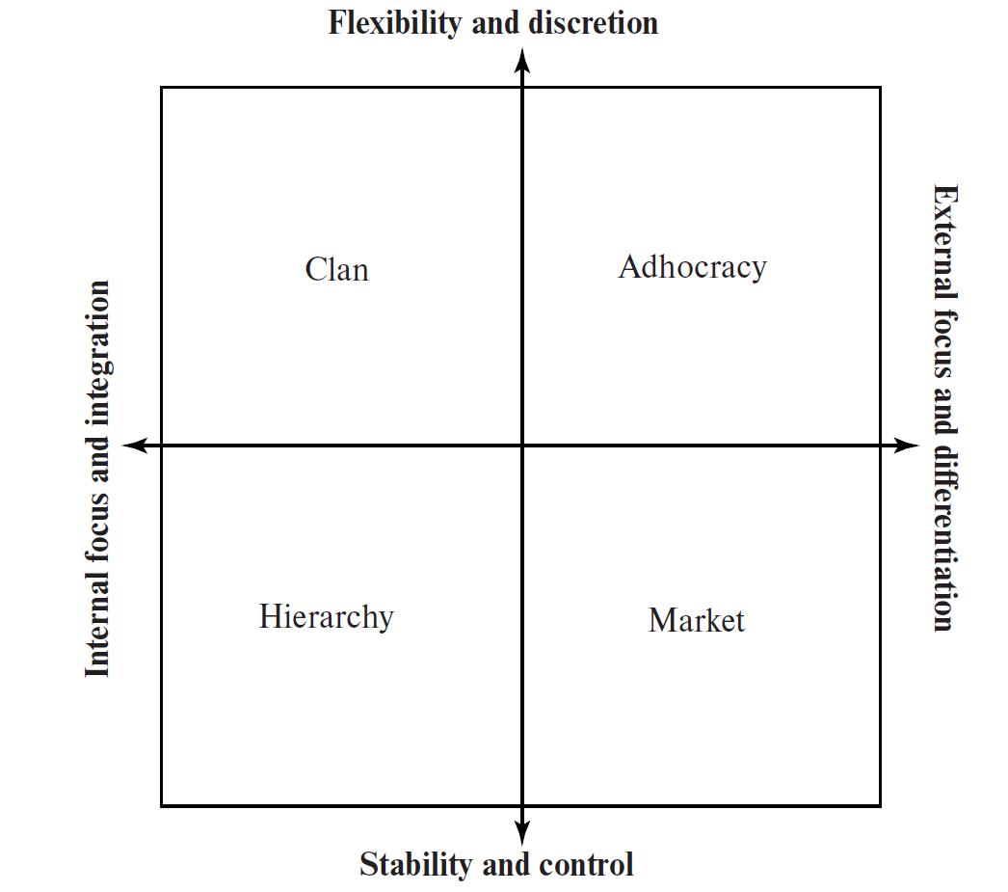
Figure 14.2: The Competing Values Framework
Access the text alternative for slide images.

Slide 18
The Competing Values Framework
Derives its name from the fact that values depicted on opposite ends of each axis are inherently in tension with each other.
An organization’s culture represents a balance or trade-off between these competing values that tends to work for that organization in its particular competitive environment.
People tend not to be consciously aware of their own organization’s culture.
People become aware of any need for culture change only when an organization’s culture is impeding organizational performance.
Designed to help organizations be more deliberate in identifying a culture more likely to be successful given their respective situations, and in transitioning to it.

Slide 19
Table 14.3: Contributions to Organizational Effectiveness of Organizational Culture Emphases
Culture Type | Primary Emphasis and Value
Clan | Creating trust, valuing affiliation and collaboration, promoting teamwork
Adhocracy | Building task involvement, creativity, and innovation; promoting autonomy and risk-taking
Market | Increasing productivity, valuing competitiveness and achievement, promoting profitability
Hierarchy | Clear rules and processes, efficiency and consistency, conformity and smooth functioning

Slide 20
An Afterthought on Organizational Issues for Students and Young Leaders
The primary reason for being familiar with organizational variables is the context they provide for understanding the leadership process at one’s own level in an organization.
Junior managers may be far better at describing the culture of a large organization.

Slide 21
The Environment
Ronald Heifetz argues that leaders not only are facing more crises than ever before but that a new mode of leadership is needed because we are in a permanent state of crisis.
Change has become so fast and so pervasive that it impacts virtually every organization everywhere, and everyone in them.
VUCA describes this new state of affairs.
    VUCA stands for volatile, uncertain, complex, and ambiguous
Leadership has never been easy and appears to be growing more difficult.

Slide 22
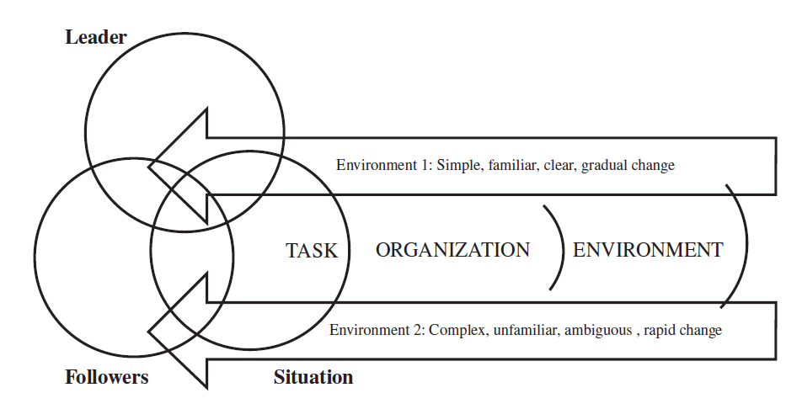
Figure 14.3: Contrasting Different Environments in the Situational Level
Access the text alternative for slide images.

Slide 23
Leading across Societal Cultures
Leaders need to have an understanding of societal culture to avoid any conflicts and misunderstandings that may occur when people from different cultures work together.
Societal culture: Learned behaviors characterizing the total way of life of members within any given society.
    Guides the distinctive mannerisms, ways of thinking, and values within particular societies.
Business leaders in the global context need to become aware and respectful of cultural differences and cultural perspectives.

Slide 24
The GLOBE Study 1
GLOBE: Acronym for a research program called the Global Leadership and Organizational Behavior Effectiveness Research Program.
Based on implicit leadership theory.
Individuals have implicit beliefs and assumptions about attributes and behaviors that distinguish leaders from followers, effective leaders from ineffective leaders, and moral from immoral leaders.
Relatively distinctive implicit theories of leadership characterize different societal cultures from each other as well as organizational cultures within those societal cultures.
    GLOBE calls these culturally endorsed implicit theories of leadership, or CLT.

Slide 25
The GLOBE Study 2
GLOBE dimensions for assessing CLT across all global cultures
Charismatic/value-based leadership: Inspires, motivates, and expects high performance from others on the basis of firmly held core values.
Team-oriented leadership: Emphasizes effective team building and implementation of a common goal among team members.
Participative leadership: Degree to which managers involve others in making and implementing decisions.
Humane-oriented leadership: Supportive and considerate leadership.
Autonomous leadership: Independent and individualistic leadership.
Self-protective leadership: Focuses on ensuring the safety and security of the individual or group member.

Slide 26
Leader Attributes and Behaviors Universally Viewed as Positive
Trustworthy.
Just.
Honest.
Foresighted.
Plans ahead.
Encouraging.
Informed.
Excellence oriented.
Positive.
Dynamic.
Motive arouser.
Confidence builder.
Motivational.
Dependable.
Coordinator.
Intelligent
Decisive.
Effective bargainer.
Win-win problem solver.
Administratively skilled.
Communicative.
Team builder.

Slide 27
Leader Attributes and Behaviors Universally Viewed as Negative
Loner.
Asocial.
Noncooperative.
Irritable.
Nonexplicit.
Egocentric.
Ruthless.
Dictatorial.

Slide 28
Examples of Leader Behaviors and Attributes That are Culturally Contingent
Ambitious.
Cautious.
Compassionate.
Domineering.
Formal.
Independent.
Individualistic.
Logical.
Orderly.
Sensitive.
Sincere.
Worldly.

Slide 29
Summary
Situations may be the most complex factor in the leader-follower-situation framework.
Situations vary in complexity and strength.
Organizational level includes both the formal organization and the informal organization.
An increasingly important variable at the environmental level is societal culture.

Slide 30
End of Main Content
Copyright ©2022 McGraw-Hill Education. All rights reserved. No reproduction or distribution without the prior written consent of McGraw-Hill Education.

Slide 31
Accessibility Content: Text Alternatives for Images

Slide 32
Figure 14.1: An Expanded Leader-Follower-Situation Model - Text Alternative
Return to parent-slide containing images.
The three circles that are part of the Venn diagram are labeled leader, followers, and situation, respectively. The circle labeled situation consists of three abstractions at the situation level. These are task, organization, and environment.
Return to parent-slide containing images.

Slide 33
Figure 14.2: The Competing Values Framework - Text Alternative
Return to parent-slide containing images.
The continuum is divided into four quadrants. The horizontal axes of the continuum, from left to right, are labeled internal focus and integration and external focus and differentiation, respectively. The vertical axes are labeled flexibility and discretion and stability and control from top to bottom, respectively. The four quadrants are labeled clan, adhocracy, hierarchy, and market.
The continuum depicts that the organizations that focus inward and emphasize stability and control have a hierarchy culture. The organizations that focus on the external environment but emphasize stability and control are called market cultures. The organizations that focus inward and emphasize high degrees of flexibility and discretion are called clan cultures. The organizations that focus on the external environment and emphasize flexibility are called market cultures.
Return to parent-slide containing images.

Slide 34
Figure 14.3: Contrasting Different Environments in the Situational Level - Text Alternative
Return to parent-slide containing images.
The diagram depicts the task, organization, and environmental levels of the situation. In the case of environment, the vector indicates two contrasting types at the situational level. The first environment is simple, familiar, clear, and involves a gradual change. The second environment is complex, unfamiliar, ambiguous, and involves a rapid change.
Return to parent-slide containing images.

